Slide 1
Kalman Filter on Embedded System
By Devin Renshaw

Slide 2
Outline
From simulation to system
Complications
Results

Slide 3
Progression
Using libraries
Simulation
Quick board setup
Fully implemented
Type | Ease | Utility
MATLAB libs | 5 | 2
MATLAB custom | 4 | 2
Arduino | 4 | 4
STM32F0 | 2 | 5

Slide 4
Arduino/STM implementation
Real-world effects
Sensor noise
Unexpected issues
Port code
Sensors
Compensation

Slide 5
Issues on Physical Devices
Non-zero mean noise
Temperature effects
Sensor bias/calibration
Sensor drift and jitter
Gimbal lock

Slide 6
Minor issues
Non-zero mean noise
Simple shift
Temperature effects
Wait for stabilization

Slide 7
Major issues
Sensor bias
Calibration techniques
Sensor drift and jitter
Multiple solutions

Slide 8
Sensor noise and drift
Jitter/noisy
Estimation technique
Kalman filters
Complementary filters (low pass)
Sensor drift
Compensation (high-pass)

Slide 9
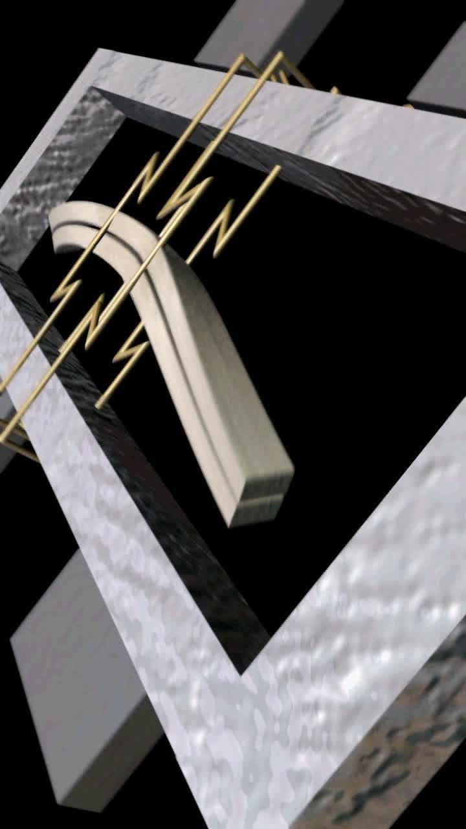
Sensor drift
What sensors drift?
Gyroscopes
Low noise, tend to drift
Can be deg/min or deg/s
Drift due to integration
Hard to mitigate internally
Solutions
Complementary sensors

Slide 10
Complementary sensors
Different sensors used
Accelerometers
Magnetometers

Slide 11
Complementary sensors
Accelerometers
Drift compensation in roll/pitch
No sensing for yaw
Magnetometers
Yaw compensation

Slide 12
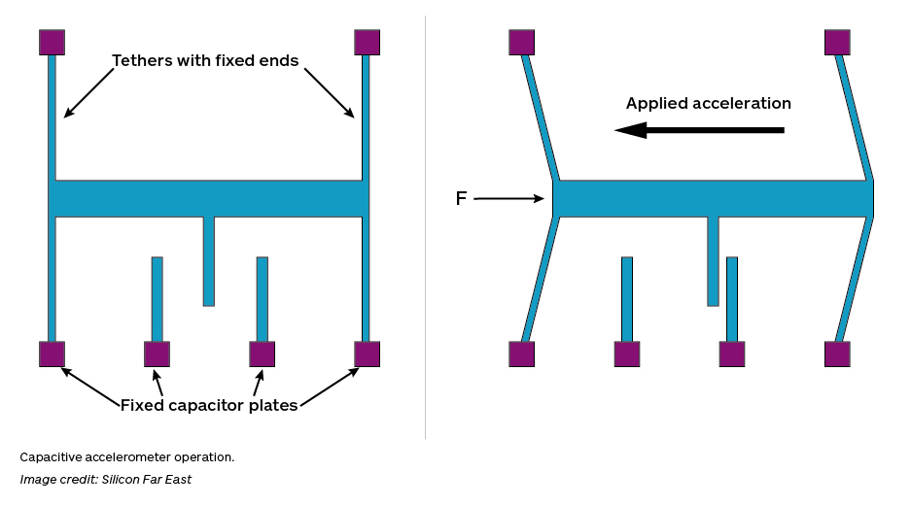
Accelerometers
Compensate for pitch/roll drift
No sensing for yaw
Linear acceleration
Noisy, but no drift

Slide 13
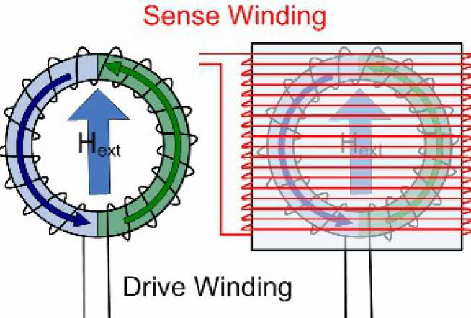
Magnetometers
Senses nearby magnetic fields
Immune to drift
Susceptible to soft/hard Fe effects

Slide 14
Hard/Soft Iron Effects
Hard Iron
Magnetic sources
Soft iron
Non-magnetized but conductive metals
These effects can be larger than Earth’s magnetic field which we want to measure

Slide 15
RESULTS

Slide 16
Timing Comparisons
 | Timing (μs)
Implementation | Complementary | Kalman
MATLAB | -- | --
Arduino | 120-150 | 2300-2500
STM32F0 | 100-120 | 2200-2300
Complementary vs. Kalman filter

Slide 17
Floating point operations
Computationally expensive
Necessary in Kalman filtering
Fixed point arithmetic didn’t cut it
No HW support for floating point in Arduino or STM32F0
Must be emulated using SW libraries

Slide 18
Floating Point Operations Cost
Complementary Filter
Kalman Filter
For both X and Y, only a handful of additions and multiplications are necessary
Relatively inexpensive
Matrix operations and many multiplications and additions are necessary
Expensive operations

Slide 19
Performance
Complementary Filter
Kalman Filter
Always underperformed Kalman filter
Often took several seconds to settle
Manual setting of α parameter
Not as accurate as Kalman
Great results
At most, took fractions of a second to converge
Automatic setting of parameters for estimation
Always returned to within 1⁰ of original position

Slide 20
Final Results
Kalman filter is great, but expensive
Low-end/power applications may benefit more from complementary filter
Characterizing physical interactions takes a long time

